Slide 1
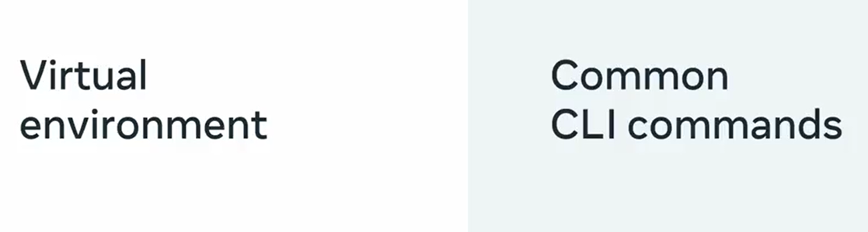

Slide 2
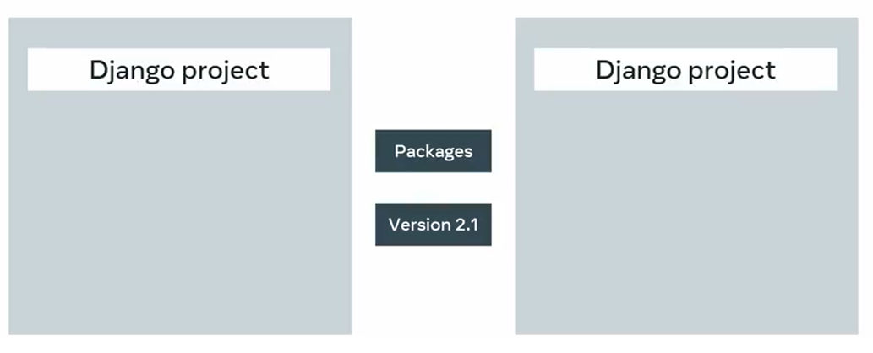

Slide 3
Virtual environments
Interpreter
Interpreter
Libraries
Libraries
Scripts
Scripts

Slide 4
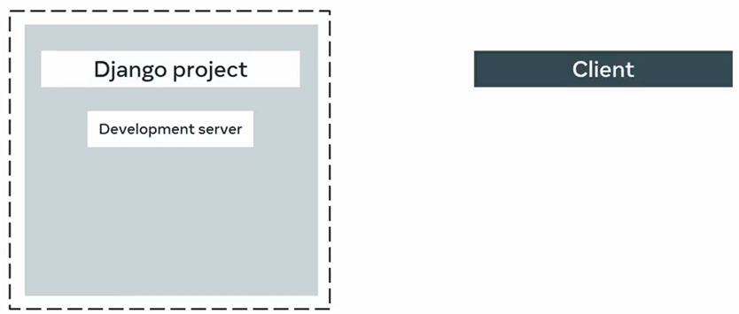
Virtual environments

Slide 5
